Slide 1
Hospitality & Tourism

Slide 2
Tourism Industry
The Travel Industry is used for
recreation,
leisure,
religious,
family
business purposes
The Travel Industry is usually used for a limited duration.

Slide 3
Hospitality
Hospitality is a broad category of job fields within the service industry that includes:
lodging,
event planning,
theme parks,
transportation,
cruise line,
additional fields within the tourism industry.

Slide 4




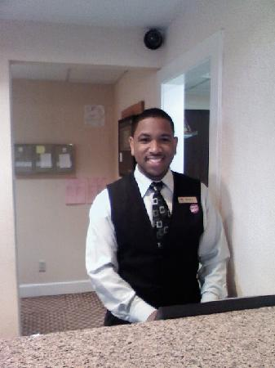


Hospitality
The hospitality industry is a multi-billion dollar industry that depends on the availability of leisure time and disposable income.
A hospitality unit (restaurant, hotel, an amusement park, etc.) consists of multiple groups of workers such as

Slide 5
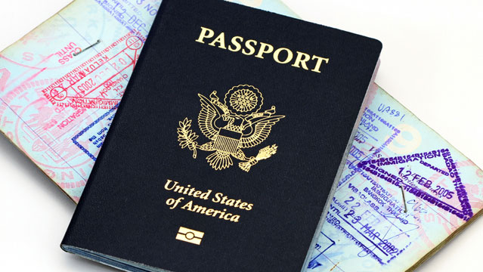
Tourist: people traveling outside their usual environment for not more than one consecutive year for leisure, business and other purposes
Passport: documentation that allow safe travel through countries

Slide 6

Careers in hospitality & tourism
Travel Agents
Tour guides
Translators
Hotel Staff
Graphic Designers (design promotional materials)
Transportation (pilots, sailors, conductors, etc)
Program Directors (cruise ships/resorts)
Entertainers
And MORE!
Notes:
Give an example of each of the following careers. Ex. Entertainers – All the characters at Disney world

Slide 7
Can you name any other careers in hospitality & tourism?

Slide 8
Significance of tourism
Is an important, even vital, source of income for many countries.
Brings in large amounts of income into a local economy.

Slide 9
Who Benefits from tourism
Transportation services
Airlines
Cruise ships
Taxicabs
Hospitality services
Hotels
Resorts
Entertainment Venues
Amusement parks
Shopping malls
Music venues
Theatres
and YOU!

Slide 10
World’s top 10 tourism destinations
France
United States
Spain
China
Italy
Turkey
Germany
United Kingdom
Russia
Thailand

