Slide 1
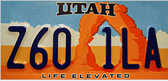
What Drives Utah’s Economy?
Economy definition: production & consumption of goods and services; management of available resources.

Slide 2
Economy – what?
Economy is the production & consumption of goods and services and management of available resources.
What are services?
What are goods?
What are resources?

Slide 3
Tourism
"Utah is no longer a secret. Utah is a ‘bucket list’ destination for tourists around the world.”
Deseret News

Slide 4
National Park Visits – 6.3 Million
Spending by tourists in Utah - $7.4 Billion
129,000 people employed by tourism industry
Utah ski visits – 4.2 Million
Total state & local taxes generated by traveler spending was $960.6 Million
State Government - $571 Million
Local Government - $389 Million
http://utahtourism.org/wp-content/uploads/2010/01/Tourism-Works-state-of-indu-10-13.pdf

Slide 5
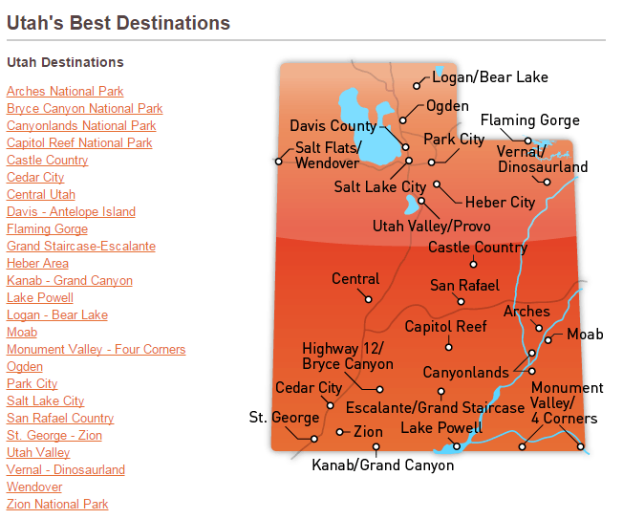

Slide 6
Utah’s Top 10 Attractions
1. Bryce Canyon
2. Arches National Park
3. Zion National Park
4. Canyonlands National Park
5. Salt Lake City
6. Park City
7. Temple Square
8. Dinosaur National Monument
9. Wasatch Mountain State Park
10. Lake Powell
http://www.attractionsofamerica.com/attractions/utah.php#.VIfd4THF-So

Slide 7
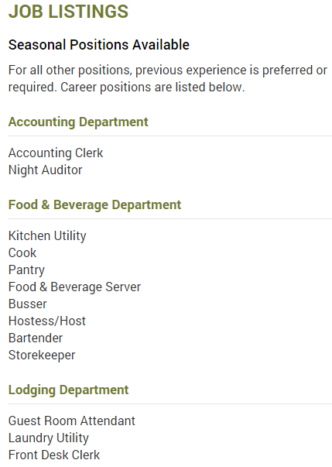
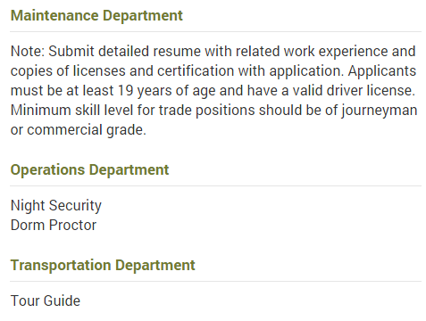
Careers that go with the top 10 attractions

Slide 8
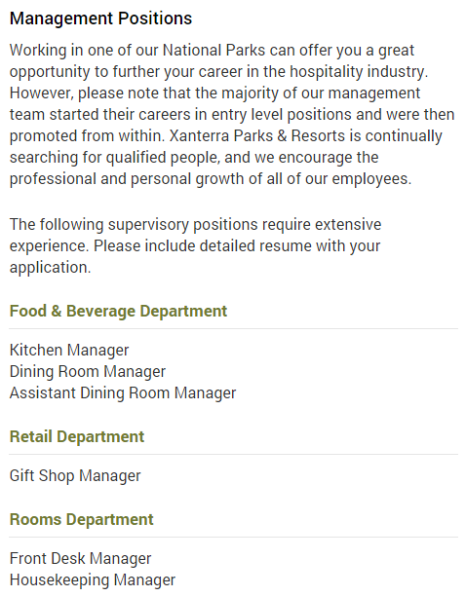
More Careers that go with the top 10 attractions

Slide 9
TOURISM IN UTAH
Tourism is a major industry in Utah, and is well known for its year-round outdoor recreational activities.

Slide 10
Tourism In Utah
With five national parks
Arches,
Bryce Canyon,
Canyonlands,
Capitol Reef,
Zion
Utah has the third most national parks of any state after Alaska and California.

Slide 11
Tourism In Utah
Utah features seven national monuments,
Two national recreation areas,
Six national forests,
Numerous state parks and monuments.

Slide 12
TOURISM IN UTAH
Utah is well known for its winter activities and has seen an increase in tourism since the 2002 Winter Olympics.
Park City is home to the US Ski Team.

Slide 13
Tourism In Utah
Utah's ski resorts are primarily located in northern Utah.
In 2008, Deer Valley, in Park City, was ranked the top ski resort in North America.
Northern Utah's ski resorts are well liked among tourists for their convenience and proximity to a large city and International Airport, as well as the close proximity to other ski resorts, allowing skiers the ability to ski at multiple locations in one day.

Slide 14
TOURISM IN UTAH
Utah features many cultural attractions such as Temple Square in Salt Lake, the Sundance Film Festival in Park City, and the Utah Shakespearean Festival in Cedar City.
Other attractions include Monument Valley, the Great Salt Lake, the Bonneville Salt Flats, and Lake Powell.
Researching ancestors and the LDS Church Family History Library brings visitors to Utah.

Slide 15
Fun Facts about Utah
45th state admitted to the Union on January 4, 1896
13th largest state
33rd most populated
2nd fastest-growing state in the US
Overall best state to live in – Gallup survey 2012
#1 Best State for Business – Forbes 2014

Slide 16
Fun Facts about Utah
Capital: Salt Lake City
Governor: Gary Herbert
Colleges & Universities: University of Utah, Utah State University, Brigham Young University, Weber State University, Utah Valley University, Salt Lake Community College, Southern Utah University, Dixie State University, Snow College, etc.

Slide 17
Fun Facts about Utah
Senators: Orrin Hatch, Mike Lee

Slide 18
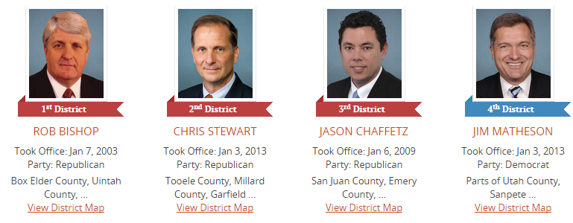
Fun Facts about Utah
Representatives: Rob Bishop, Chris Stewart, Jason Chaffetz, Jim Matheson

Slide 19
Fun Facts about Utah
Representatives: Rob Bishop, Chris Stewart, Jason Chaffetz, Mia Love

Slide 20
Fun Facts about Utah
Origin of name: Ute Indians
Nickname: Beehive State
Motto: Industry
Emblem: Beehive
Slogan: Life Elevated
Bird: California Seagull
Animal: Rocky Mountain Elk
Fish: Bonneville Cutthroat Trout
Insect: Honeybee
Tree: Quaking Aspen
Fruit: Cherry

Slide 21
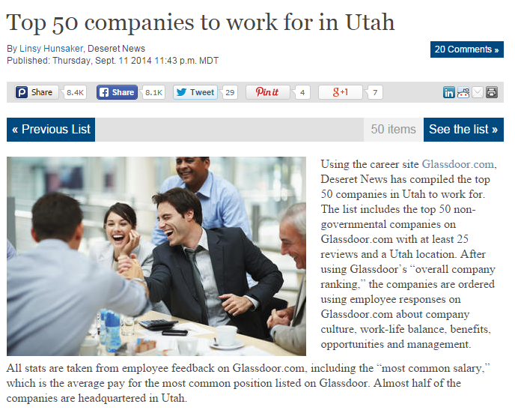
Top 50 Companies to work for in Utah
Click on the picture for the link

