Slide 1
Human Resources
What do I need to know?

Slide 2
Human Resources
1
People who work
For the company
2
Physical location
In the building

Slide 3

What does the “HR Department” do?
Helps employees
  Advertises available jobs
  Accepts job application
  Screens job applicants
  Answers employee questions about:
    Pay
    Benefits
    Company rules
  Trains employees
  Problems with others
  And more
Helps the company
  Advertising available jobs
  Accepts & screen job applications/applicants
  Makes sure company follows government rules
  Makes sure employees follow company rules
  Solves employee problems
  Solves pay problems
  Solves benefit problems
  Terminates employees
  And more

Slide 4
Human Resources
What is the definition of
Human resources?

Slide 5

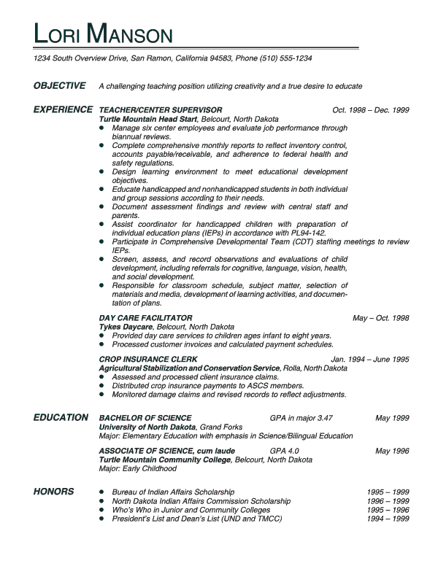
Resumé

Slide 6


What is the definition of
Resumé?

Slide 7


Job Application

Slide 8
What is the definition
of a job application?

Slide 9
Job Interview
Act your best
Face-to-face
Dress in your best
Be polite
Speak kindly
Be clean
Be appropriate

Slide 10
Job Interview
Questions you might be asked:
Why do you want to work here?
What are your strengths?
What are your weaknesses?
What is your previous work experience?
Tell us more about you.
Interviewer is thinking:
Will he/she get along with the other employees?
Will she be on time for work?
Will he be able to learn the job?

Slide 11
Job Interview
What is the definition of a
Job Interview?

Slide 12
Employee
What is the definition of an
Employee?
Someone who works for a business for pay

Slide 13
Employer
What is the definition of an
Employer?
A business or owner who pays people to work for the company

Slide 14
Orientation
Company rules
Meet the managers
Dress code
About the company
Work hours
Lunch hours
Breaks
Benefits
About your job
What is the definition of
Orientation?
A meeting where you learn about the company and your job duties.
Code of Conduct

Slide 15

Wage
Pay for each hour worked.
If you don’t work
you don’t get paid!
What is the definition of
Wage or wages?

Slide 16

Salary
Pay based on one year of earnings.
Divide by 12 to get the monthly pay.
What is the definition of
Salary?

Slide 17

Commission
No sales, no pay
Pay based on % of sale.
What is the definition of
Commission?

Slide 18
Benefits
What is the definition of employment Benefits?
Paid time off for vacations
Paid sick days
Insurance: health, dental, vision
Social Security retirement
Child care
Transportation: car, bus, train, gasoline allowance
Incentives to work in addition to pay.

Slide 19
Supervisor
Someone in charge of YOU!
What is the definition of a
Supervisor?
Also called Managers or Team Leaders

Slide 20

Co-Worker
What is the definition of a Co-worker?
People you work with.

Slide 21

Teamwork
What is the definition of Teamwork?
Working together for a common goal

Slide 22
Ethics
Right
Wrong
Code of Conduct
What is the definition of
Ethics?
Knowing and doing what is right!
Even when no one is looking.

